Slide 1
Makeup Application Device for Bilateral Upper Limb Amputees
Catherine Trojanowski
December 9, 2021

Slide 2
Agenda
Introduction to Proposed Solution
Need for Proposed Solution
PDS Development
Design Review
Future Plans & Cost

Slide 3
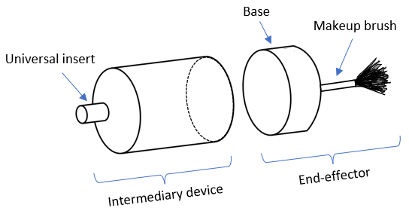
Introduction to Proposed Solution
The proposed design consists of 3 components:
An intermediary device
Makeup brush end-effectors
Change-out station / makeup case
The intermediary device will be designed to integrate with flexion units via a universal insert¹.
The makeup case will have two levels and can hold 8 cosmetic brushes.
Brushes will be held in place via square rods that pass through holes present in the base of the end-effector.

Slide 4
Need for Proposed Solution
Bilateral upper limb amputations can significantly diminish an individual’s self-esteem.
The proposed solution allows bilateral transhumeral or transradial upper limb amputees to apply makeup independently.
Makeup can be empowering and allow for an increase in self-confidence and self-love.
A makeup application device designed for bilateral amputees is not currently available on the market.
²

Slide 5
PDS Development
Identify the need
1
Identify the target market
2
Gather information
3
Brainstorm potential solutions & specifications
4
Obtain feedback
5
Refine & evaluate the solutions & specifications
6
Select a concept
7

Slide 6
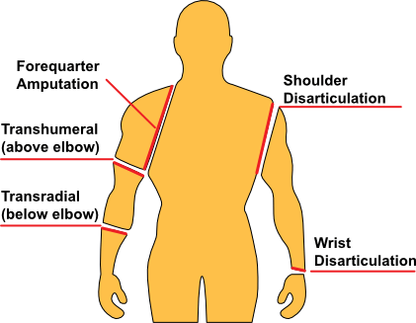
Target Population
Target population: bilateral transhumeral or transradial upper limb amputees that utilize prosthetics.
The majority of bilateral upper limb amputees utilize prosthetics.
Special considerations:
Flexion of the terminal device is critical for bilateral amputees.
³

Slide 7
Design Requirements
Proposed makeup application device must:
integrate with body-powered prosthetics
enable flexion
be small and travel-friendly
allow individuals to use their own makeup
be easy to use and manufacture
be durable and attach strongly to prosthetic
⁴

Slide 8
Design Requirements Cont.
Component | Physical Requirement
 | Dimensions^{5, 6, 7} | Weight^{5, 6} | Colour | Materials^{8, 9}
Makeup case / change-out station | Length: 9.0 in. Width: 6.0 in. Height: 6.0 in. | 1 kg | Exterior: silver, pink, blue Interior: silver | Exterior: PVC, aluminum Interior: PVC
Intermediary device | Length: 2.5 in. Diameter: 2.0 in. 12 mm insert | 100 g | White | PVC
Brush end-effector | Length: 2.5 in. (0.5 in. base, 2.0 in. cosmetic) Diameter: 2.0 in. | 5-20 g | Base: white Brush: colours used by commercially available brands | Base: PVC Brush: materials used by commercially available brands

Slide 9
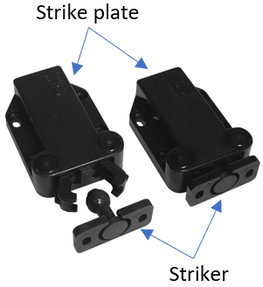
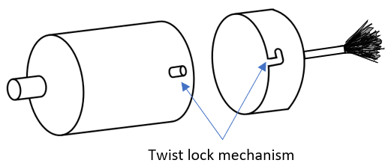
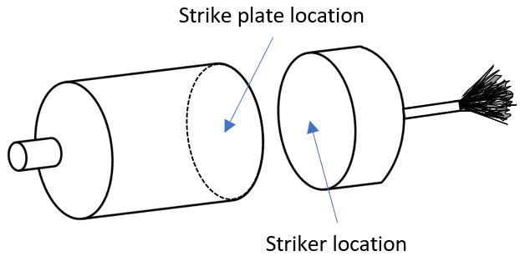
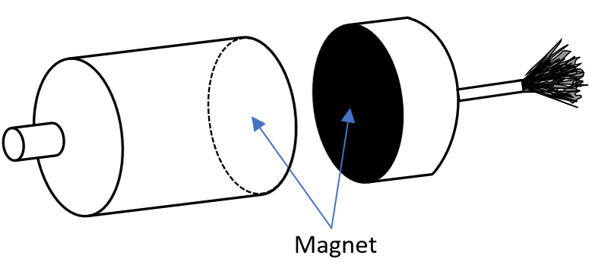
Design Concepts
Concept 1: Twist Lock
Concept 2: Push Latch
Concept 3: Magnet
¹⁰

Slide 10
Concept Evaluation
A weighted decision matrix was used to evaluate the design concepts.
The concepts were rated using a 5-point scale.
5-point Scale | Description
0 | Inadequate
1 | Weak
2 | Satisfactory
3 | Good
4 | Excellent
¹¹

Slide 11
Concept Evaluation Cont.
Selection Criteria | Weighting Factor | Concept 1: Twist Lock |  | Concept 2: Push Latch |  | Concept 3: Magnet
 |  | Rating | Weighted Score | Rating | Weighted Score | Rating | Weighted Score
Ease of use | 0.35 | 1 | 0.35 | 3 | 1.05 | 4 | 1.40
Attachment strength | 0.35 | 4 | 1.40 | 4 | 1.40 | 2 | 0.70
Durability | 0.20 | 4 | 0.80 | 3 | 0.60 | 4 | 0.80
Ease of manufacture | 0.10 | 4 | 0.40 | 2 | 0.20 | 3 | 0.30
Total | 1.00 |  | 2.95 |  | 3.25 |  | 3.20

Slide 12
Lessons Learned
Both the quality and quantity of planning is important in delivering a successful product
Critical to speak with clinicians and potential users throughout the product development process
Can incorporate concepts from other fields of engineering to create unique design solutions

Slide 13
Should It Be Built?
Positive feedback from clinical and client contacts.
Interested in discussing the project during subsequent phases of the design process.
Proposed solution:
should allow for more efficient makeup application for amputees
has the potential to improve user self-esteem
Should it be built? Yes!
¹²

Slide 14
Future Plans
Phase 0: Planning
Phase 1: Concept Development
Phase 2: System-level Design
Phase 5: Production Ramp-Up
Phase 4: Testing and Refinement
Phase 3: Detail Design
Preliminary material selection has been completed.
Testing will be required to confirm material suitability.
Testing must be done to verify if the design will work as intended.
An initial prototype will be built and tested internally.
Identified deficiencies will be corrected and updated prototypes will be manufactured. These will be tested by selected customers.

Slide 15
Future Plans Cont.
Phase 0: Planning
Phase 1: Concept Development
Phase 2: System-level Design
Phase 5: Production Ramp-Up
Phase 4: Testing and Refinement
Phase 3: Detail Design
Potential problems with product manufacturing include:
Supply chain interruption
Fluctuation in material cost
The proposed makeup application device must meet all regulations governing cosmetic manufacturing in North America.
Push latches are generally considered to be reliable devices¹³, however damage is possible.
A manual outlining proper use of the device will be included with the product.

Slide 16
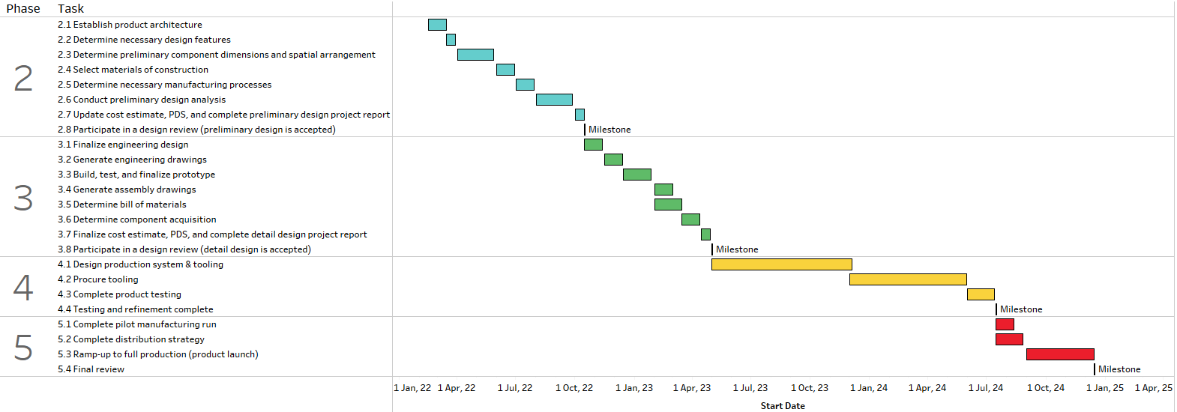
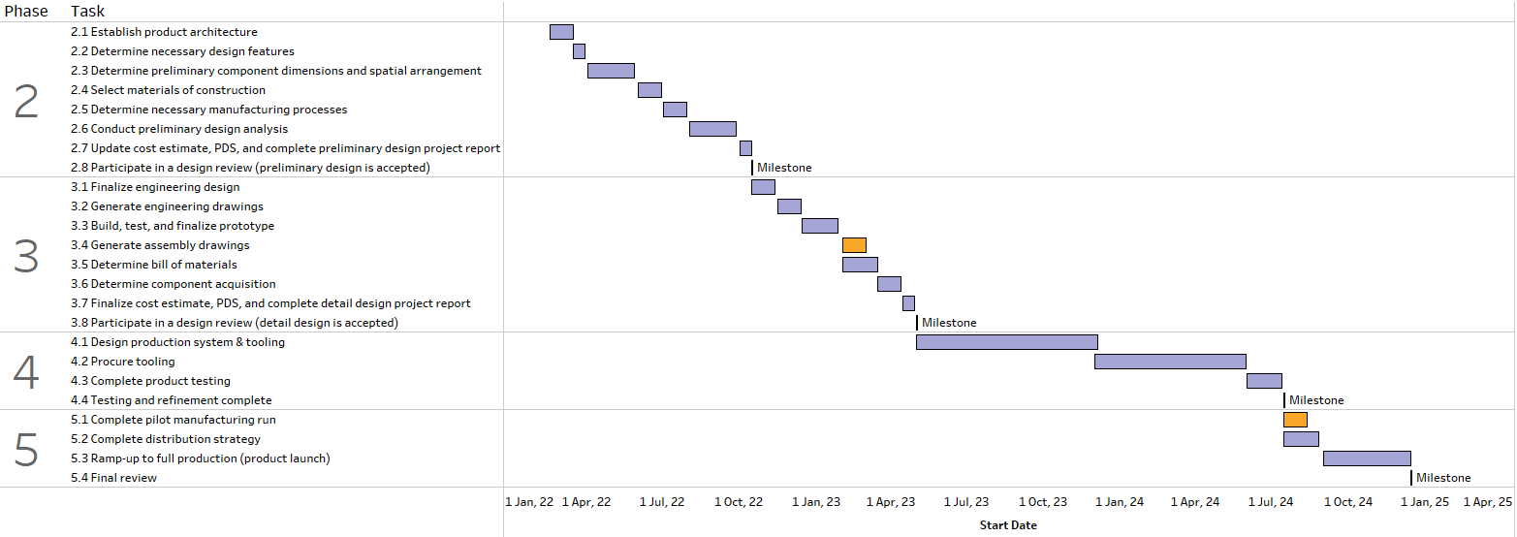
Project Schedule

Slide 17
Cost Estimate (CAD)
Upfront Cost | CNC Machine | $2,500.00¹⁴
 | Other Tooling | $1,000.00
Parts | PVC | $4.50¹⁵
 | Insert | $10.00
 | Latch | $7.00¹⁶
 | Makeup Case | $112.50¹⁷
 | Brushes | $25.00¹⁸
Labor | Intermediary Device | $6.25
 | End-effectors | $25.00
 | Assembly | $5.00
Total | Upfront Cost per Device | $1.30
 | Part Cost per Device | $159.00
 | Labor Cost per Device | $36.25
 | Cost of Device | $196.55

Slide 18
Thank You!

Slide 19
References
C. Trojanowski, “Interview with Dr. Amanda Mayo.” 2021.
“Upper Extremity Amputation,” University of Michigan Health. https://www.uofmhealth.org/conditions-treatments/rehabilitation/upper-extremity-amputation (accessed Oct. 31, 2021).
“Upper Limb Prosthetics,” Central Prosthetics and Orthotics. https://centralcpo.com/prosthetics/upper-limb-prosthetics/ (accessed Nov. 25, 2021).
“Checklist PNG Images Transparent Free Download,” PNG Mart. https://www.pngmart.com/image/tag/checklist (accessed Nov. 25, 2021).
“Makeup Train Case Silver,” Wayfair. https://www.wayfair.ca/storage-organization/pdp/rebrilliant-makeup-train-case-silver-c004235628.html?piid=1008556678&fbclid=IwAR1hX1ykjse7VFgVKW0rsGnlRfmXQCL4zJEZB-DBaWwdipBOKu8L8UpZc2s (accessed Nov. 25, 2021).
“Hosmer Prosthetic Model 5XA Hook, Aluminum,” Amputee Store. https://amputeestore.com/products/hosmer-model-5xa-prosthetic-hook (accessed Nov. 25, 2021).
“Upper Extremity Prosthetics Product Catalogue,” Fillauer, 2017. https://fillauer.com/wp-content/uploads/2019/12/Upper-Extremity-Catalog-2017.pdf (accessed Nov. 25, 2021).

Slide 20
References Cont.
“Pro PVC/Aluminum Makeup Rolling Case Bag Lockable Cosmetic Wheeled Trolley Box,” eBay. https://www.ebay.com/itm/401354227031?fbclid=IwAR3AkMdn4Pmn8WBCfAoffERxxujUBXD4FEETYGyLiUlXuKUJU-5K60Iixqw (accessed Nov. 25, 2021).
S. Jackson, V. Volk, and J. Prosise, “Novel Design for a Simple and Affordable End-Effector for an Upper-Limb Prosthesis,” Int. J. Serv. Learn. Eng. Humanit. Eng. Soc. Entrep., vol. 12, no. 1, pp. 62–73, 2017.
“Black Non Magnetic Touch Latch,” Formed. https://www.formed-uk.com/black-non-magnetic-touch-latch-p22942 (accessed Nov. 25, 2021).
G. E. Dieter and L. C. Schmidt, Engineering Design, 5th ed. New York, NY: McGraw-Hill, 2013.
“How to Use Open-Ended Survey Questions +25 Examples,” SurveyLegend. https://www.surveylegend.com/customer-insight/open-ended-survey-questions/ (accessed Nov. 25, 2021).
“Non-Magnetic Touch Latches,” Sugatsune. https://global.sugatsune.com/eu/en/arch/categories/200508 (accessed Nov. 25, 2021).
“How Much Does a CNC Machine Cost?,” Make It From Metal. https://makeitfrommetal.com/how-much-does-a-cnc-machine-cost/ (accessed Dec. 5, 2021).

Slide 21
References Cont.
“PVC Plastic Rod - 2" Diameter x 6 ft. Long,” Global Industrial. https://www.globalindustrial.ca/p/pvc-plastic-rod-2-diameter-x-6-ft-long?ref=42 (accessed Dec. 5, 2021).
“Sugatsune Non-Magnetic Touch Latch,” Woodworker’s Hardware. https://www.wwhardware.com/sugatsune-non-magnetic-touch-latch-sumc37?queryID=d1c877f016796e1c4ca75fdaf5c103f6&objectID=209&indexName=production_default_products (accessed Dec. 5, 2021).
“Zimtown 9"x6"x6" Pro Aluminum Makeup Train Jewelry Storage Box Cosmetic Bag Lockable Case Organizer Pink,” Walmart. https://www.walmart.com/ip/Zimtown-9-x6-x6-Pro-Aluminum-Makeup-Train-Jewelry-Storage-Box-Cosmetic-Bag-Lockable-Case-Organizer-Pink/780820911 (accessed Dec. 5, 2021).
“Makeup Brushes 8 Pieces Makeup Brush Set Cosmetics Professional Face Powder Foundation Blush Eyeshadow Makeup Brush Tool Travel Size (Pink),” Walmart. https://www.walmart.ca/en/ip/Makeup-Brushes-8-Pieces-Makeup-Brush-Set-Cosmetics-Professional-Face-Powder-Foundation-Blush-Eyeshadow-Makeup-Brush-Tool-Travel-Size-Pink/PRD2RQC2PLJOVMW (accessed Dec. 5, 2021).

Slide 22
Appendix: Cost Estimate (CAD)
Upfront Cost | CNC Machine | $2,500.00¹⁴
 | Other Tooling | $1,000.00 | Assumption.
Parts | PVC | $4.50¹⁵
 | Insert | $10.00 | Assumption.
 | Latch | $7.00¹⁶
 | Makeup Case | $112.50¹⁷
 | Brushes | $25.00¹⁸
Labor | Intermediary Device | $6.25 | Assuming $25/hour for labor, 4 devices made per hour.
 | End-effectors | $25.00 | Assuming $25/hour for labor, 8 devices made per hour.
 | Assembly | $5.00 | Assuming $20/hour for labor, 4 kits assembled per hour.
Total | Upfront Cost per Device | $1.30 | Divide $3500 by initial market demand (2730 units).
 | Part Cost per Device | $159.00
 | Labor Cost per Device | $36.25
 | Cost of Device | $196.55

